Slide 1

HEBREWS
THE PIONEER
HEBREWS 2:5-13

Slide 2
Are not all angels ministering spirits sent to serve those who will inherit salvation?
It is not to angels that he has subjected the world to come, about which we are speaking. But there is a place where someone has testified:
Hebrews 1:14, 2:5
NIV

Slide 3
“What is mankind that you are mindful of them, a son of man that you care for him? You made them a little lower than the angels; you crowned them with glory and honor and put everything under their feet.” In putting everything under them, God left nothing that is not subject to them. Yet at present we do not see everything subject to them.
Hebrews 2:5–13
NIV

Slide 4
But we do see Jesus, who was made lower than the angels for a little while, now crowned with glory and honor because he suffered death, so that by the grace of God he might taste death for everyone. In bringing many sons and daughters to glory, it was fitting that God, for whom and through whom everything exists,
Hebrews 2:5–13
NIV

Slide 5
should make the pioneer of their salvation perfect through what he suffered. Both the one who makes people holy and those who are made holy are of the same family. So Jesus is not ashamed to call them brothers and sisters. He says, “I will declare your name to my brothers and sisters; in the assembly I will sing your praises.”
Hebrews 2:5–13
NIV

Slide 6
And again, “I will put my trust in him.” And again he says, “Here am I, and the children God has given me.”
Hebrews 2:5–13
NIV

Slide 7
Prayer

Slide 8
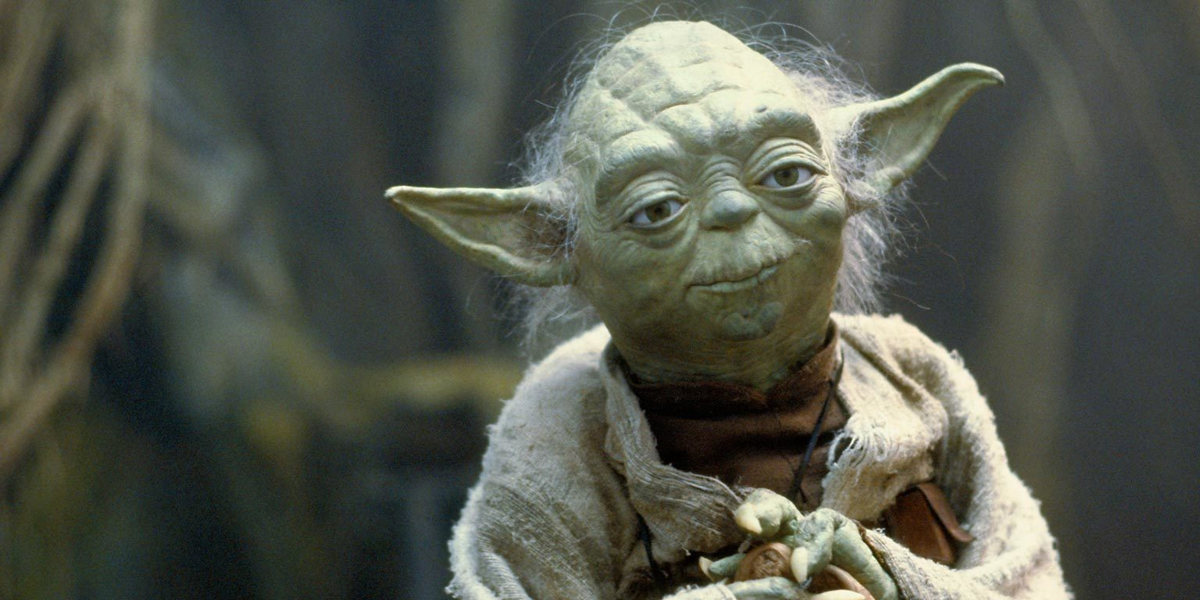

Slide 9
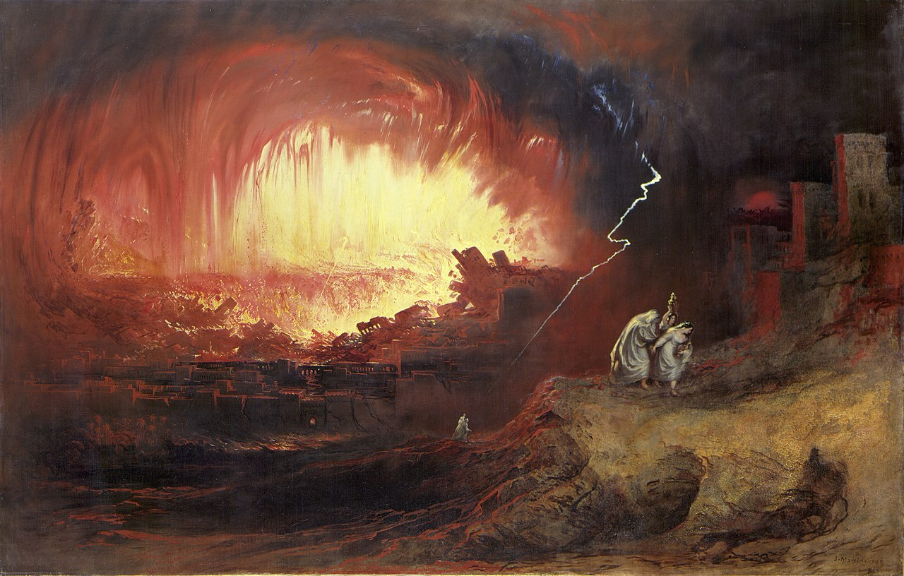
ANGELS DESTROYING SODOM

Slide 10
It is not to angels that he [God] has subjected the world to come [now and not yet Kingdom of God], about which we are speaking.
Hebrews 2:5
NIV

Slide 11
IT SEEMS JESUS’ HUMANITY (OR HUMILITY) WAS AN ISSUE.

Slide 12

HOW CAN HE POSSIBLY SAVES US?

Slide 13
But there is a place where someone has testified: “What is mankind that you are mindful of them, a son of man that you care for him? You made them a little lower than the angels; you crowned them with glory and honor and put everything under their feet.” In putting everything under them, God left nothing that is not subject to them. Yet at present we do not see everything subject to them.
Hebrews 2:6–8
NIV

Slide 14
YOU HAVE FORGOTTEN WHO YOU ARE.

Slide 15
WHY IS GOD MINDFUL OF US? WHY DOES HE CARE FOR US?

Slide 16
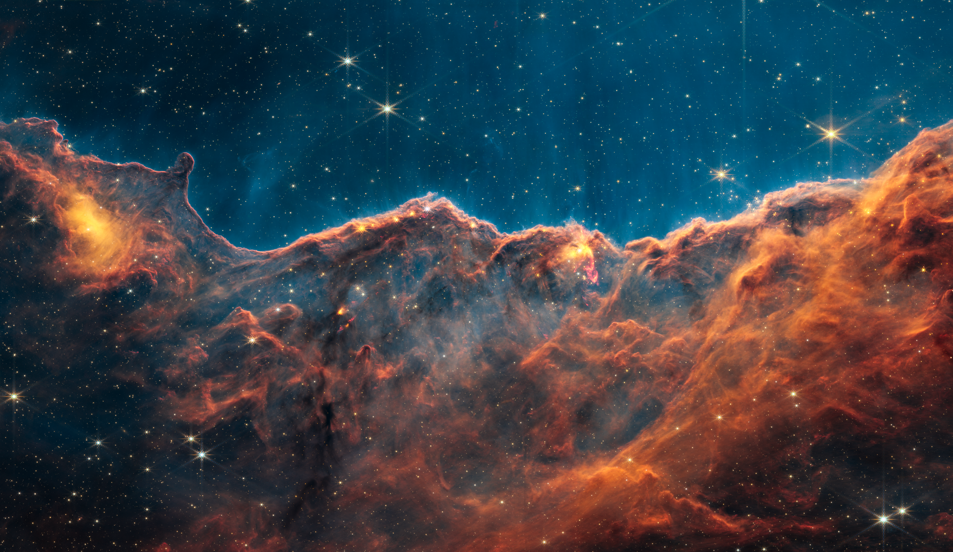
Carina Nebula from the James Webb Telescope

Slide 17
Then God said, “Let us make mankind in our image, in our likeness, so that they may rule over the fish in the sea and the birds in the sky, over the livestock and all the wild animals, and over all the creatures that move along the ground.”
Genesis 1:26
NIV

Slide 18

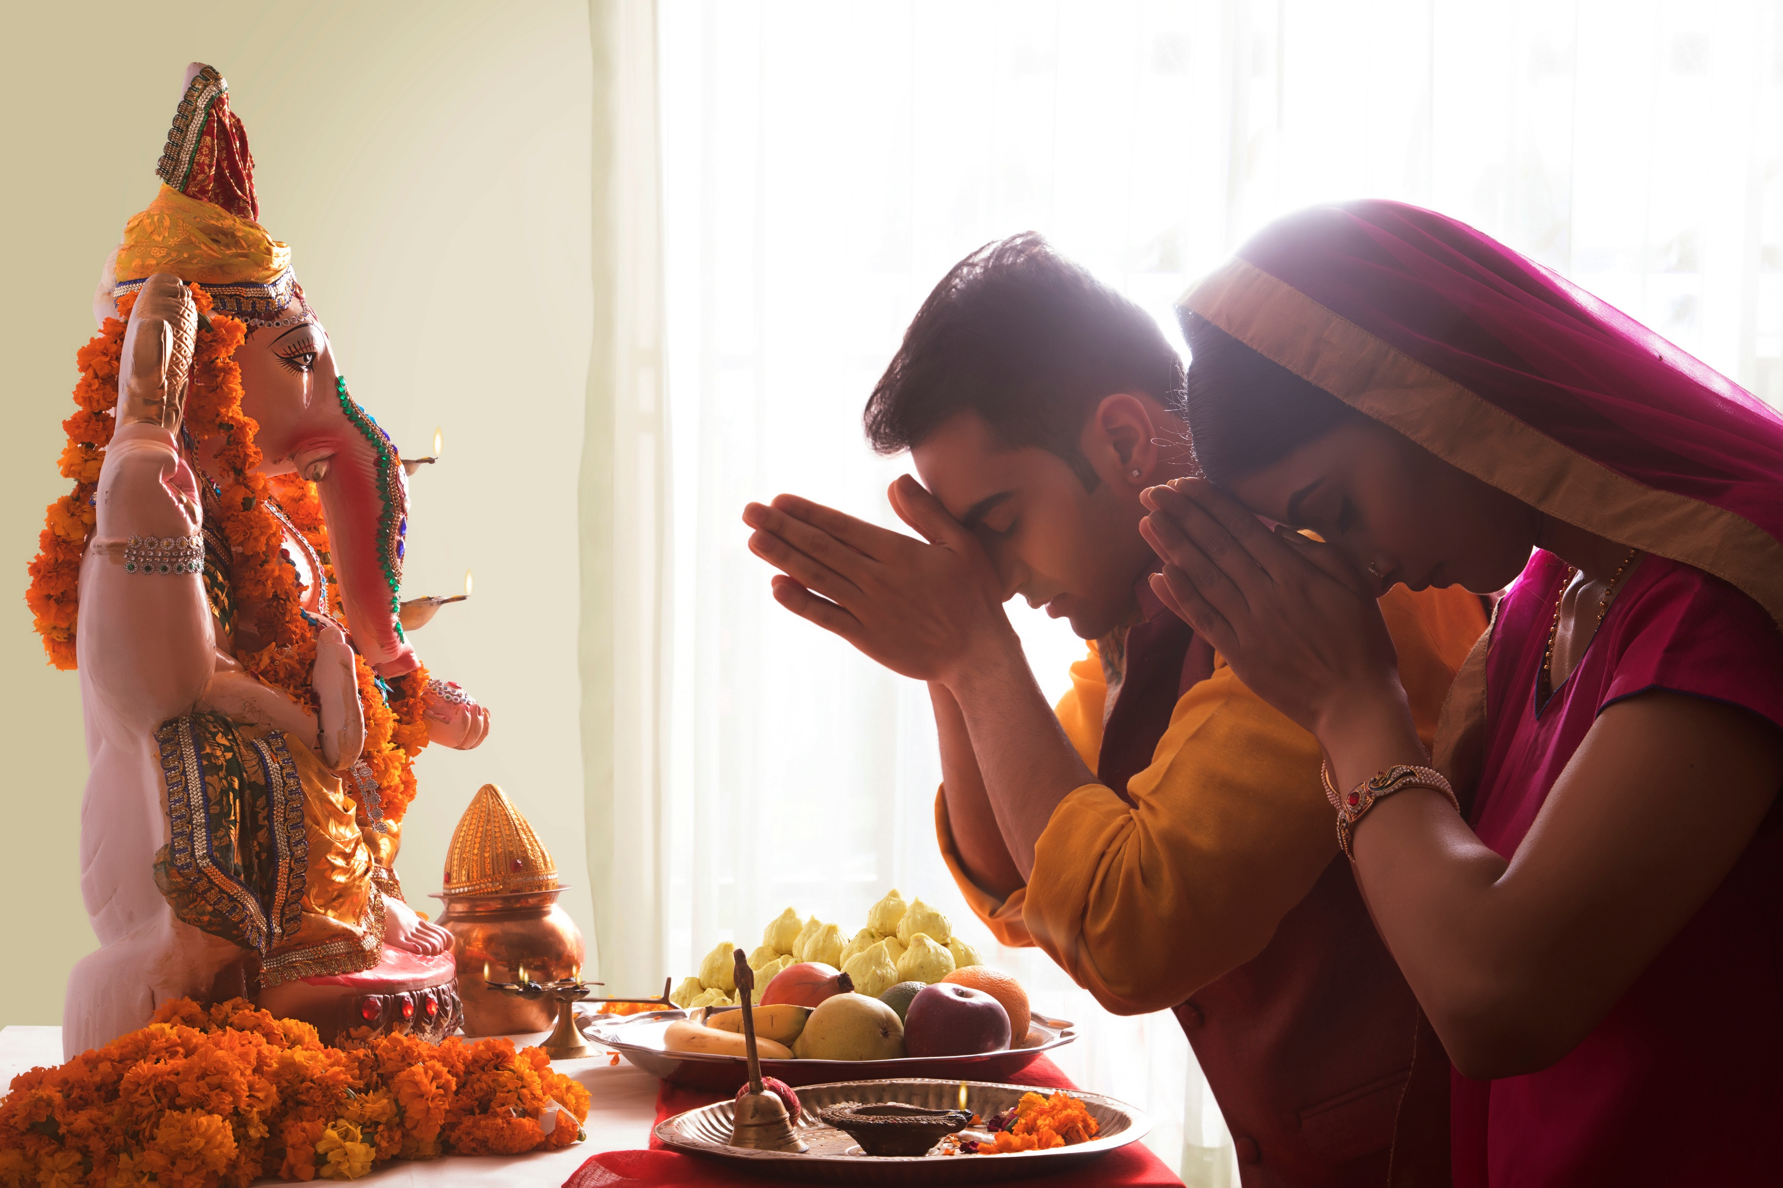
YAHWEH = THE LIVING GOD
IDOLS = DEAD GODS
LIVING IMAGES
DEAD IMAGES

Slide 19
YOU HAVE FORGOTTEN WHAT YOU ARE SUPPOSED TO BE.

Slide 20
Yet at present we do not see everything subject to them.
Hebrews 2:8
NIV

Slide 21


Slide 22
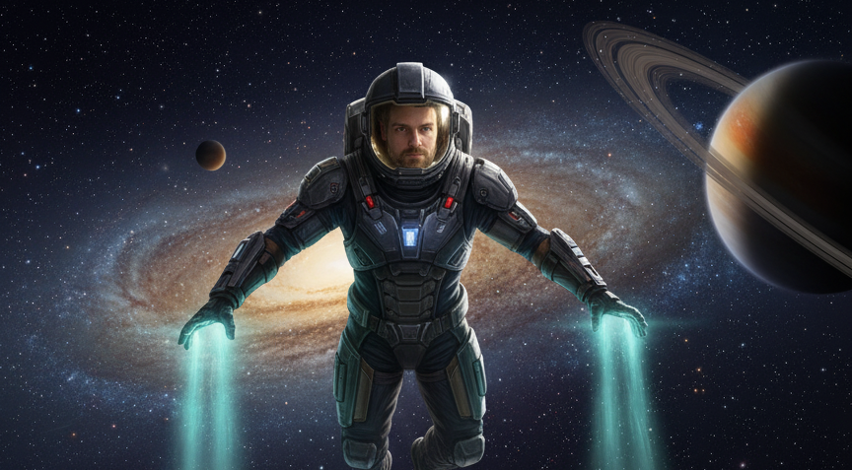

Slide 23
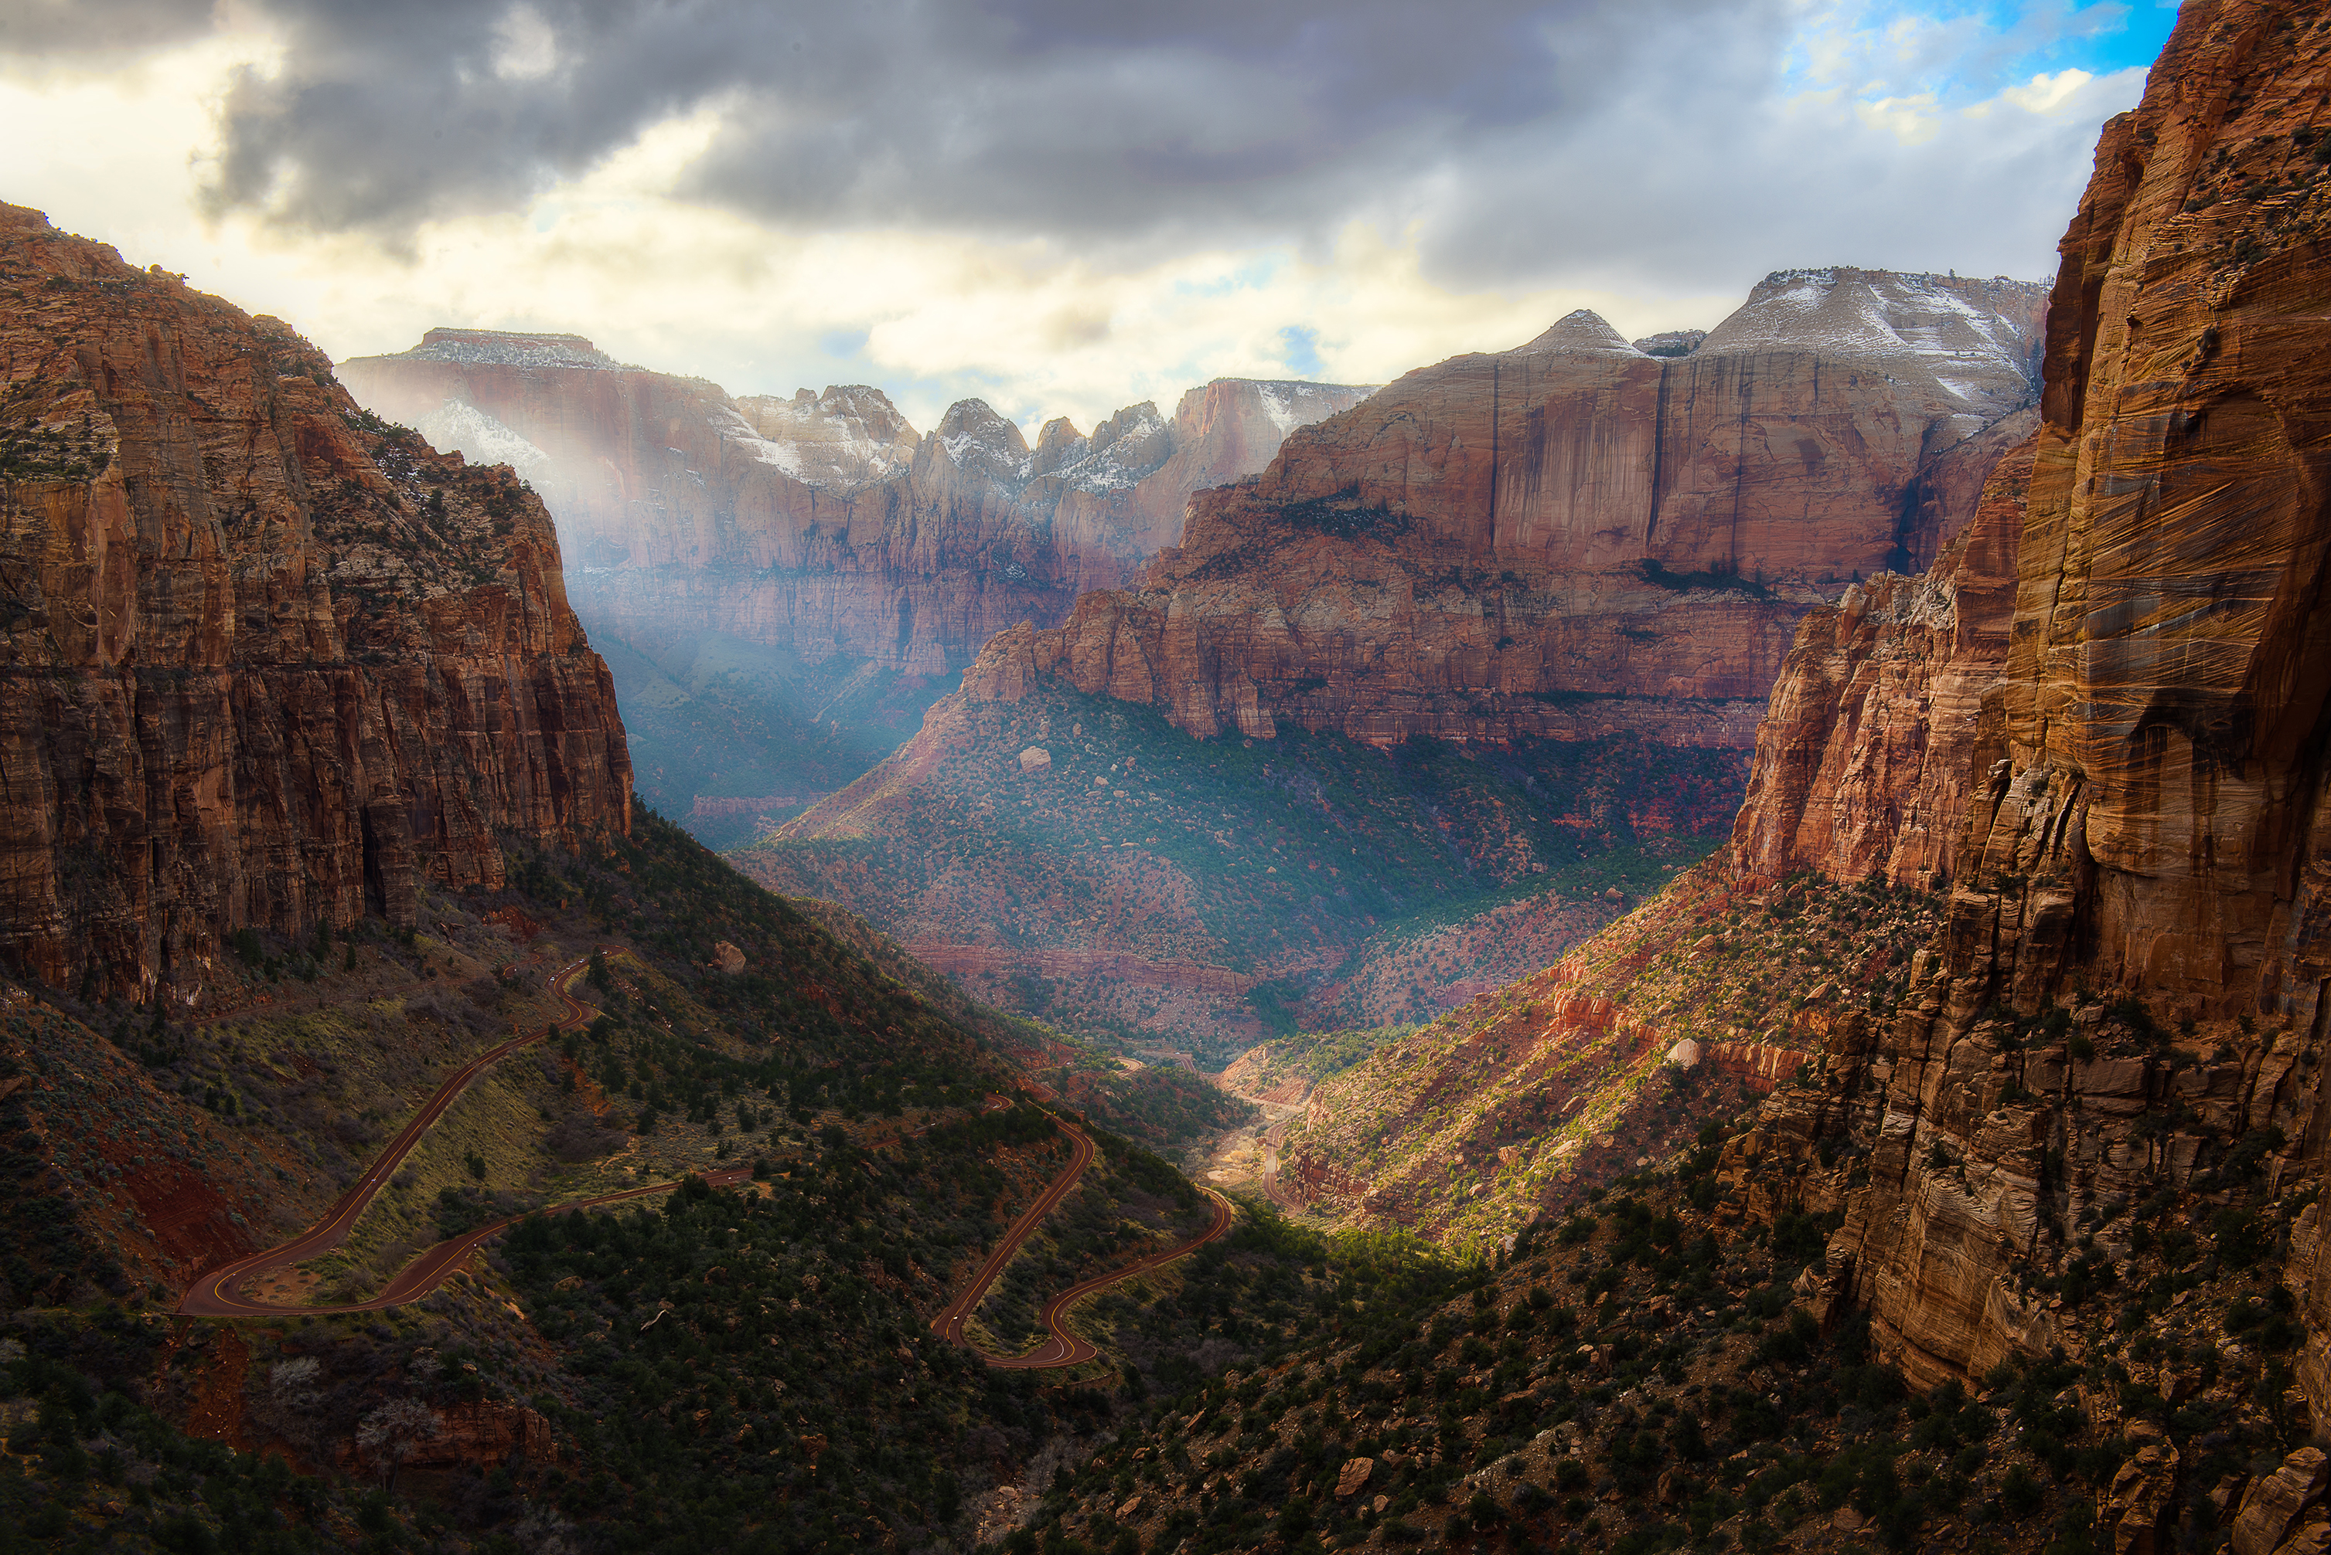
THE
SHOULD
BE
THE
IS
“THE GAP”

Slide 24
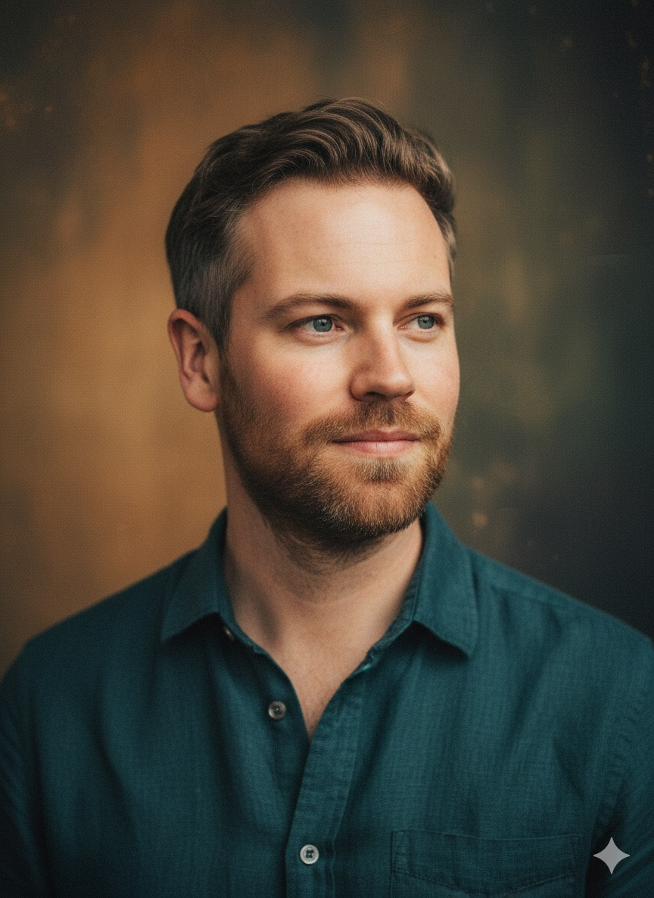
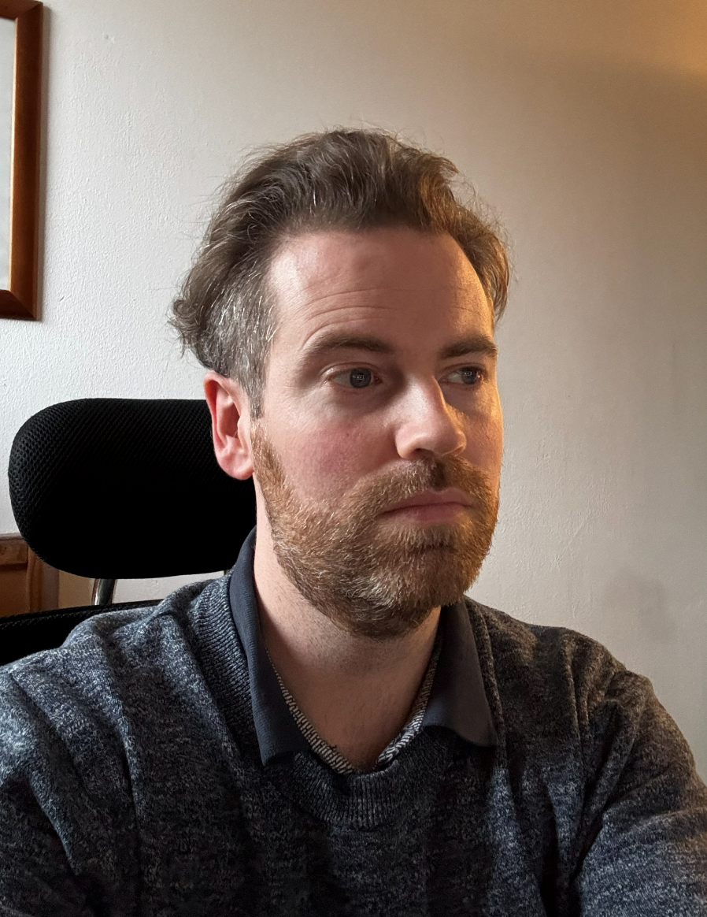
VS
IDEAL DEAN
REAL DEAN

Slide 25
DO YOU FEEL THIS GAP?

Slide 26
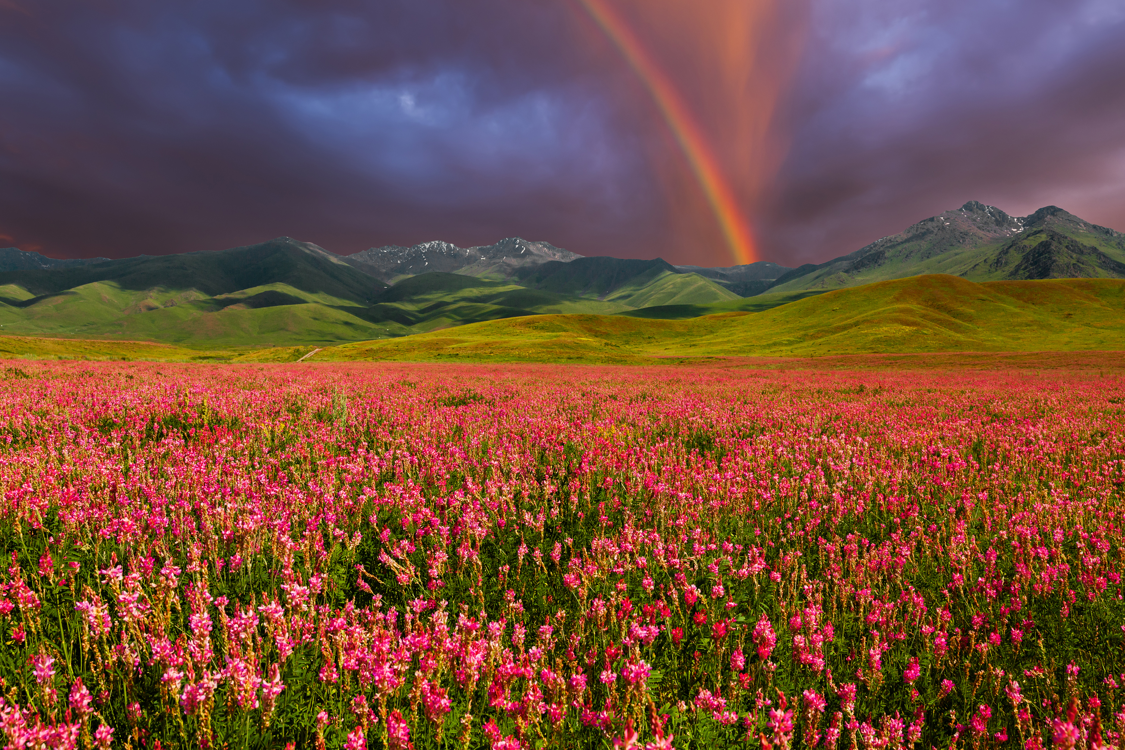

Slide 27
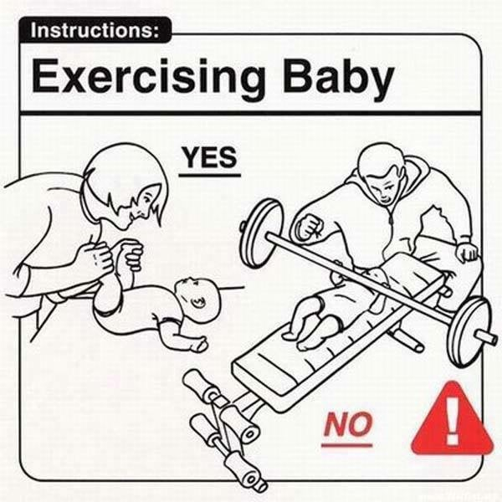

Slide 28
WE NEED TO STOP COMPARING OURSELVES WITH EACH OTHER, BUT WITH WHAT WE SHOULD HAVE BEEN.

Slide 29
WHERE DO WE GO WITH THIS GAP?

Slide 30
But we do see Jesus, who was made lower than the angels for a little while, now crowned with glory and honor because he suffered death, so that by the grace of God he might taste death for everyone.
Hebrews 2:9
NIV

Slide 31
BUT JESUS.

Slide 32
SHOULD BE = IS

Slide 33
In bringing many sons and daughters to glory, it was fitting that God, for whom and through whom everything exists, should make the pioneer of their salvation [Jesus] perfect through what he suffered.
Hebrews 2:10
NIV

Slide 34


Slide 35
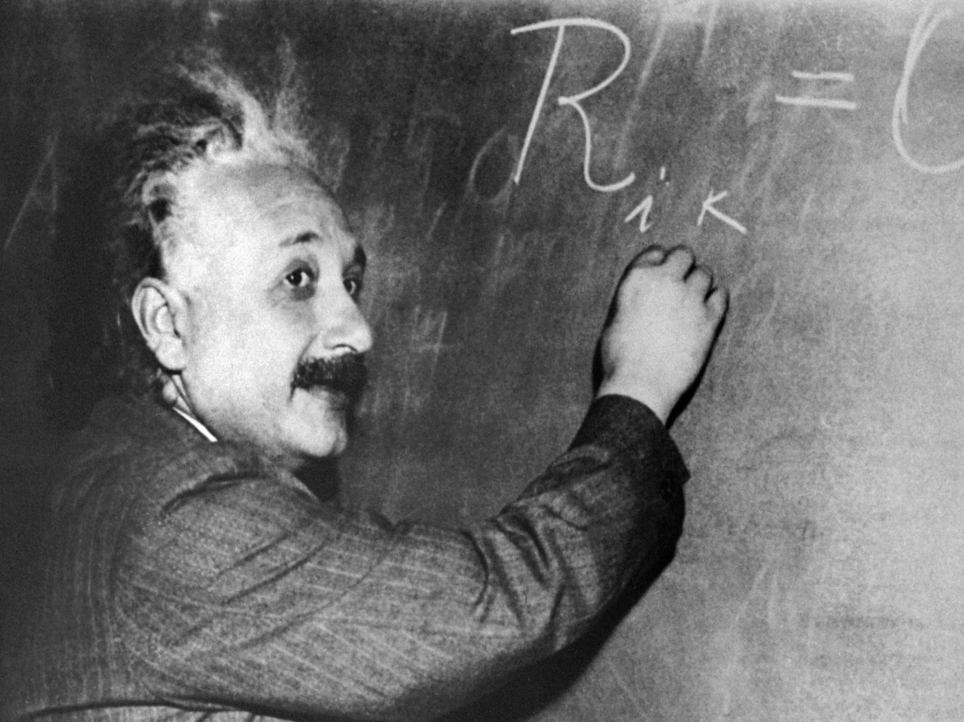

Slide 36
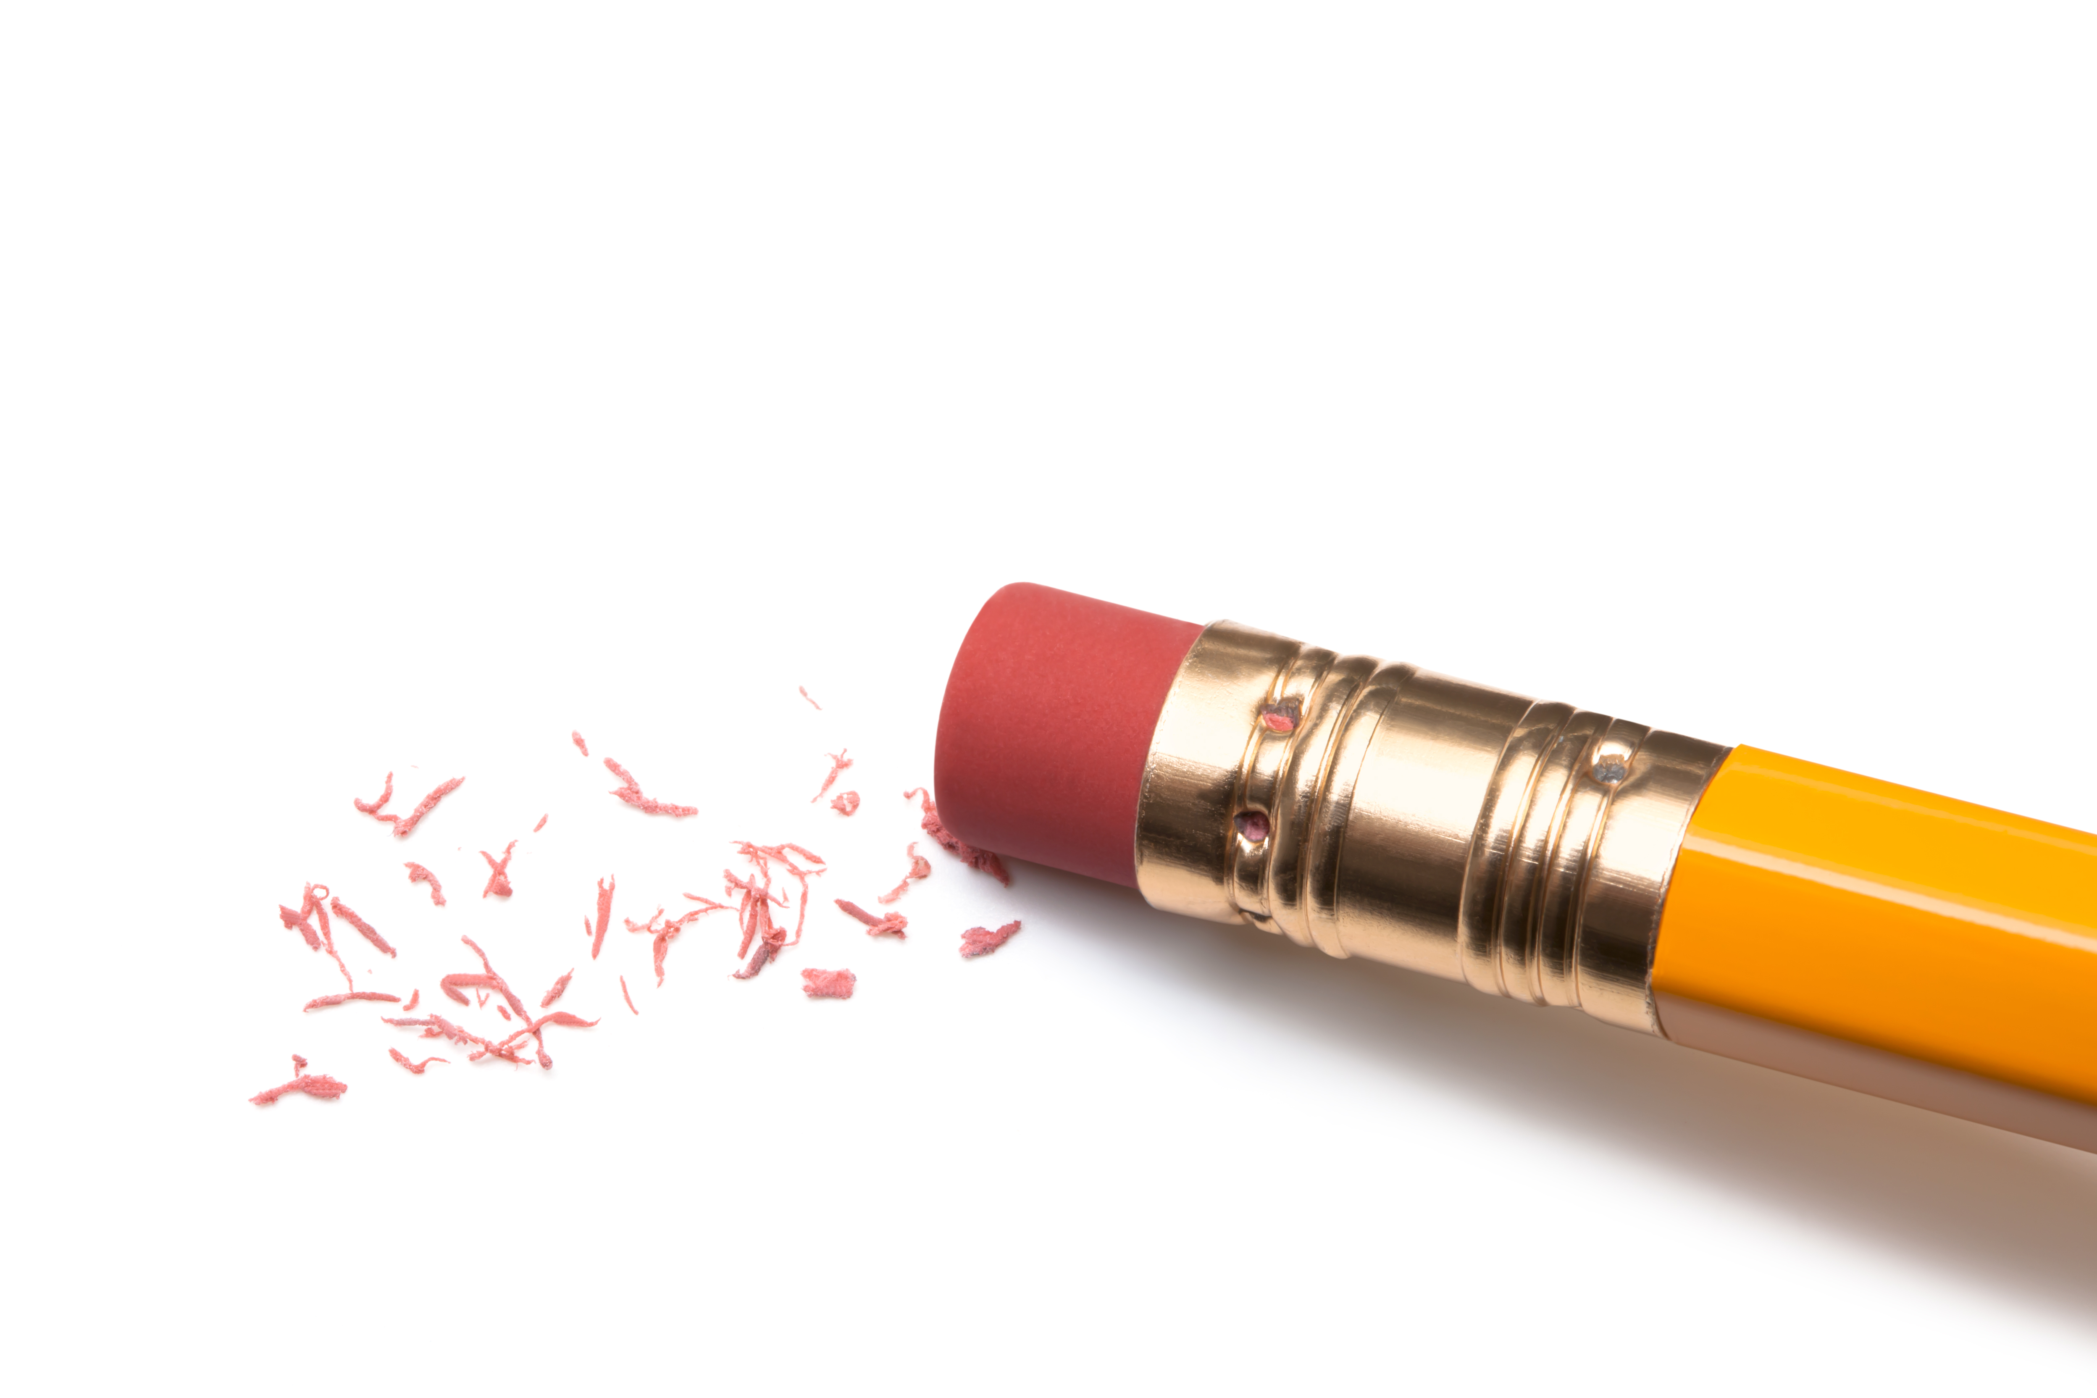
THE GAP BETWEEN THE SHOULD BE AND THE IS WILL BE ERASED.

Slide 37
DOES IT MAKE YOU HAPPY?

Slide 38


Slide 39
WHEN WE STILL LIVE WITH THE GAP?

Slide 40
IF YOU DO NOT FEEL THAT GAP, YOU HAVE NOT SEEN ENOUGH OF JESUS YET.

Slide 41
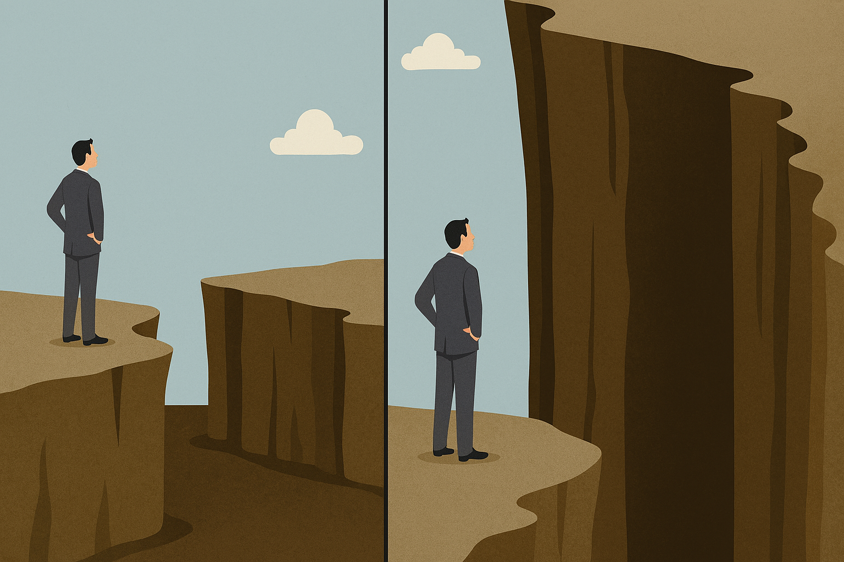

Slide 42
Both the one who makes people holy [present active = Jesus keeps working] and those who are made holy [present passive = we are being worked on] are of the same family [lit. "are of one"]. So Jesus is not ashamed [present] to call them brothers and sisters.
Hebrews 2:11–13
NIV

Slide 43
JESUS IS NOT ASHAMED OF YOUR GAP AND NEITHER SHOULD YOU BE.

Slide 44

Response
MINISTRY TIME

